Slide 1
Poetic Form
Pastoral & Sonnets
https://www.poets.org/poetsorg/text/poetic-form-

Slide 2
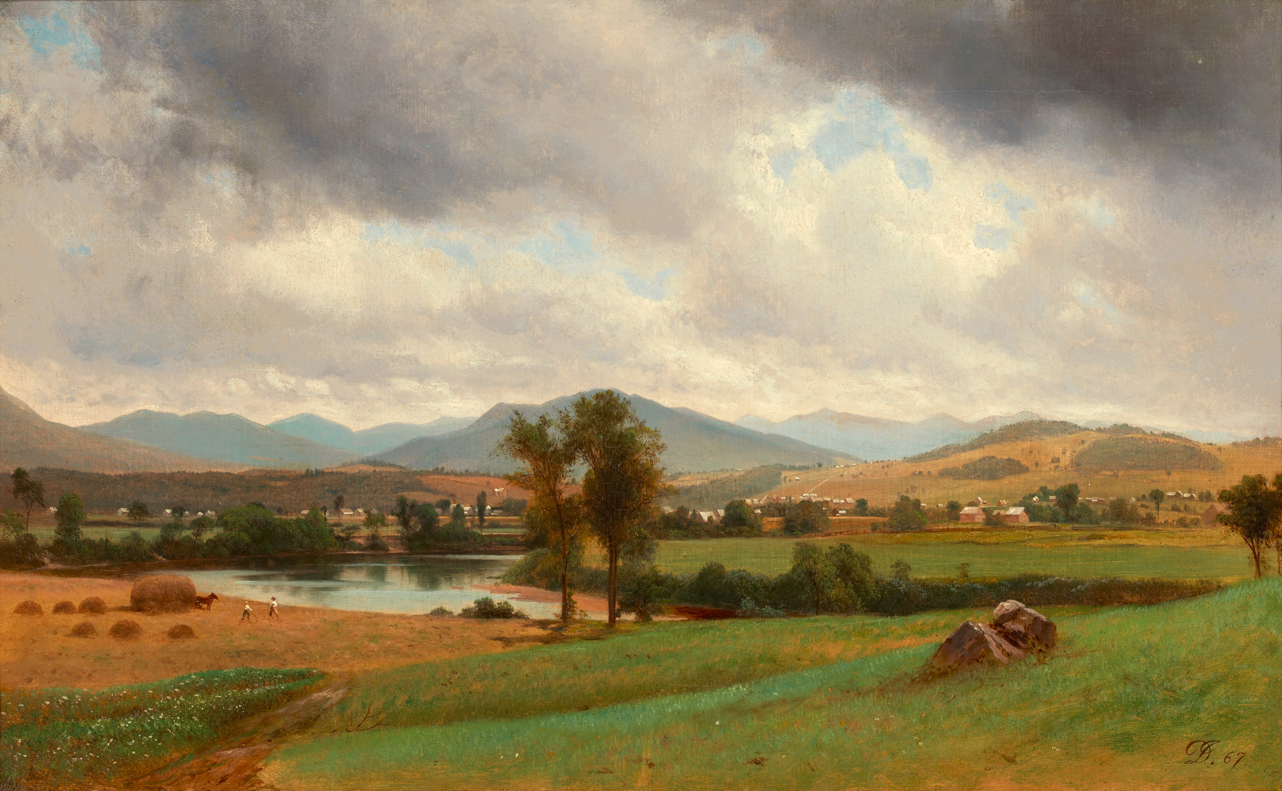
Pastoral
Viewed alternately as a genre, mode, or convention in poetry (as well as in literature, art, and music), the pastoral tradition refers to:
- a lineage of creative works that idealize rural life and landscapes, while the term “pastoral” refers to individual poems or other works in the tradition.
This style of writing emerged early on in human literary history though Virgil and Homer, prior to the common era.
During the Italian Renaissance several poets imitated
Virgil, including Dante, Petrarch, and Boccaccio,
followed by Bernardo Tasso, Luigi Tansillo, and
Giambattista Marino.
These later poets wrote examples of the pastoral lyric,
shorter poems describing beautiful rural landscapes
(or “locus amoenus, “Latin for “beautiful place”) and
depicting the country as a setting of innocence.

Slide 3
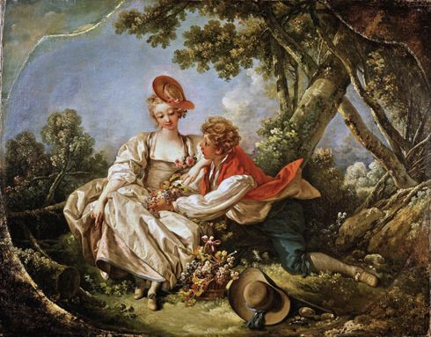
Pastoral Poems & Irony
Conventions of pastoral poetry were established by sophisticated urban poets
These idealized portrayals of rural life perpetuated fantasies and misconceptions about the rural lifestyle.

Slide 4
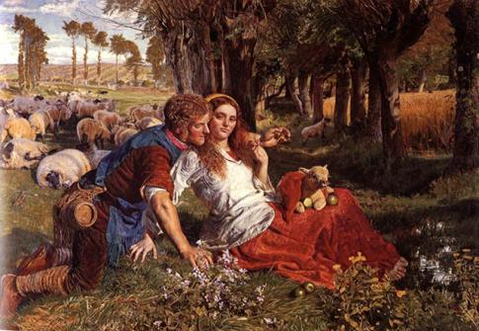
Pastoral Poems & Irony
Descriptions of undemanding rustic chores, such as watching over sheep from atop a sunny hill, functioned for some poets as critiques of city or court life.
The seemingly perfect leisure of outdoor solitude also embodies erotic fantasies, as shepherds are portrayed chasing after pretty young girls, abandoning their responsibilities.

Slide 5
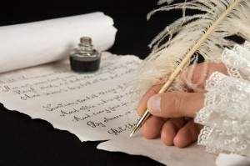
The Sonnet
The name comes from the Italian sonetto, which means “a little sound or song”
the sonnet is a popular classical form that has compelled poets for centuries.
Traditionally, the sonnet is:
a fourteen-line poem written in iambic pentameter
It employs one of several rhyme schemes
It adheres to a tightly structured thematic organization.
It has a recognizable turn or “volta” (where the mood/tone/focus shifts or changes)

Slide 6
Sonnet Types
Petrarchan
Named after Italian poet Petrarch
Shakespearean
Also known as the “English sonnet”
“And yet, by heaven, I think my love as rare As any she belied with false compare.”
divided into two stanzas
the octave (the first eight lines) followed by the answering sestet (the final six lines).
The tightly woven rhyme scheme, abba, abba, cdecde or cdcdcd, is suited for the rhyme-rich Italian language
presents an argument, observation, question, or some other answerable charge in the octave
a turn, or volta, occurs between the eighth and ninth lines.
This marks a shift in the direction of the argument or narrative, turning the sestet into the vehicle for the counterargument, clarification, or whatever answer the octave demands
three quatrains (stanzas of 4 lines) and a couplet follow this rhyme scheme: abab, cdcd, efef, gg.
The the final couplet is very important,
It may conclude, amplify, or even refute the previous three stanzas, often creating an epiphanic quality to the end.
In Sonnet 130 of William Shakespeare’s epic sonnet cycle, the first twelve lines compare the speaker’s mistress unfavorably with nature’s beauties. But the concluding couplet swerves in a surprising direction:

